Slide 1


NYU Cyber Fellows
CS GY 6573
Penetration Testing
Recon Lab
©2021 NYU Tandon School of Engineering

Slide 2
Recon
It's important to understand that there are many ways to recon our target
Internet searching, DNS, whois, social media, job postings, company websites, physical surveillance, social engineering, wireless sniffing, etc
Recon can be very open ended
Recon-ng is one of many tools to help save us time from manually searching websites for people, emails, domain names, IP addresses, etc.
Recon can also be done using files we find online, receive from email exchanges, or other means
Searching for file metadata is another method to also perform passive recon on our target

Slide 3
Before getting started
We are diving into tools starting with these lab sections
Tools are very power, and we can accomplish much with their aid
Because of their capability, they are also equally powerful to work against us
Cause lots of frustration (this lab)
Cause lots of damage (future labs)
So before moving onto the tools, an IMPORTANT POINT

Slide 4
Important Point
A reoccurring problem with automated tools is finding the needle in the haystack
We end up with lots of results, sometimes too many. We need to sift through it, weed out false positives, and make sense of it all
Understanding the tool, what it is doing, and controlling the output is one way to help mitigate this issue and avoid frustration

Slide 5

Target Recon
with
Recon-ng

Slide 6
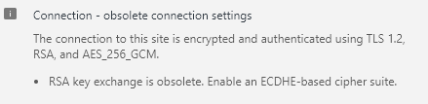
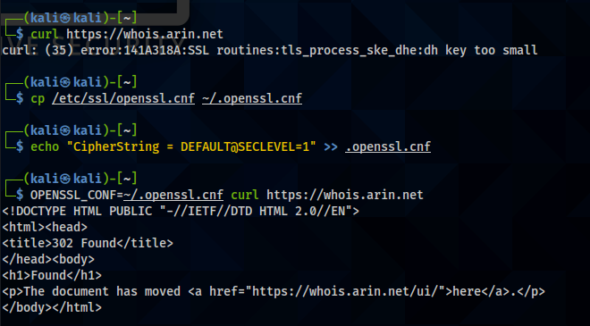
Temporary Hack to make this lab work right – Security Downgrade
We’ll be using a tool that connects to https://whois.arin.net
Unfortunately, this website since early 2020 has used an insecure key exchange – RSA
OpenSSL will not connect to this site unless we downgrade security
Create a copy of your openssl.ncf
$ cp /etc/ssl/openssl.cnf ~/.openssl.cnf
Add this line to the end
$ echo "CipherString = DEFAULT@SECLEVEL=1" >> .openssl.cnf
When running any application, we specify the conf file we want to use by changing the OPENSSL_CONF environment variable

Slide 7
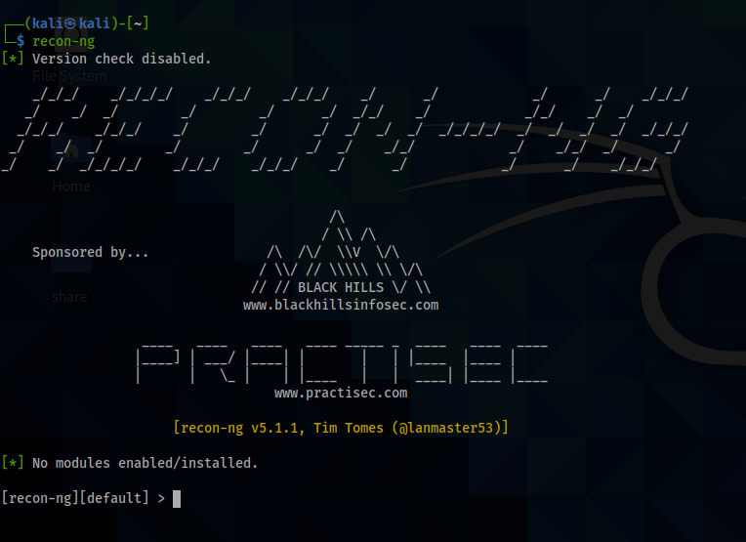
Recon-ng
We start recon-ng by typing it into the terminal
$ recon-ng
Or for the temporary fix
$ OPENSSL_CONF=~/.openssl.cnf recon-ng

Slide 8
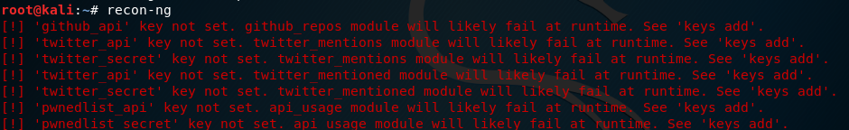
Errors
Old versions - you may get lots of errors.
Not a problem since we're not using any APIs yet
Ignore for now
Newest version does not show these errors instantly, but errors will come out after installing modules that need those keys.

Slide 9
Recon-ng intro
Recon-ng supports tab competition
Try help to see a list of possible commands
[recon-ng][default] > help
Show is one of the more useful commands, alone it will display options
[recon-ng][default] > show
Data in recon-ng is stored in tables with different fields
Let’s look at the tables
[recon-ng][default] > db schema
Some of these fields will need to be populated to run off some commands
Most of this data is for storing our results
If we give recon-ng a command it doesn’t recognize, it will pass it to our shell
[recon-ng][default] >shell ping google.com –c 4
We should see Google.com pinged 4 times

Slide 10
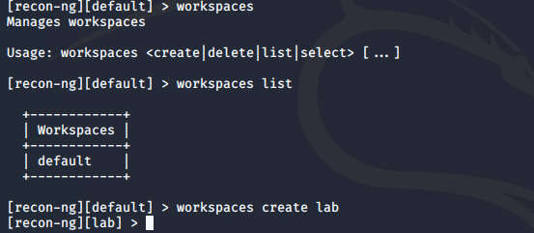
Recon-ng workspaces
Recon-ng keeps workspaces so we can save results of different penetration tests
Let’s look at the workspaces now, then create a new one
[recon-ng][default] > workspaces
[recon-ng][default] > workspaces list
[recon-ng][default] > workspaces create lab
Notice how our prompt switched to the new workspace?

Slide 11
Recon-ng modules
A module is a specific task that recon-ng will execute based on the parameters you provide it e.g. ‘interesting file finder’.
List the possible modules, broken down into categories
[recon-ng][lab] > modules search
‘Recon’ category modules are listed as
recon/[source_data]-[unknown_data]/[module name]
Our source is info we have and added already
Unknown data is what we’re looking for
Different from version 4, Recon-ng v5 doesn’t have modules pre-installed by default, user needs to add modules manually by using its ‘marketplace’

Slide 12
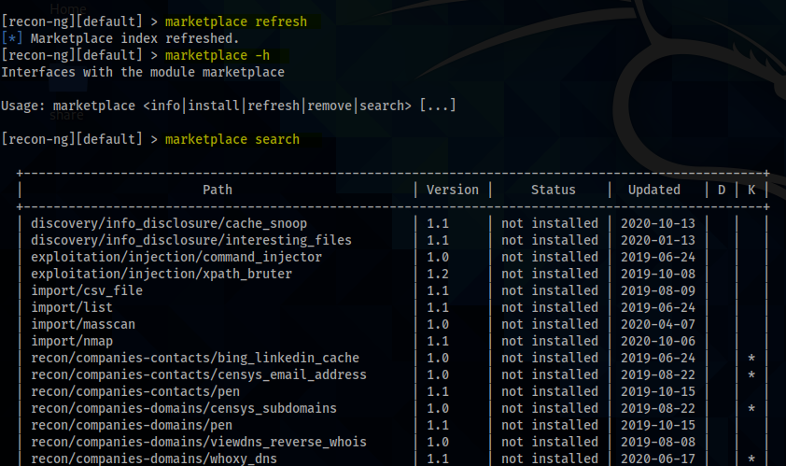
marketplace
Recon-ng used the recon-ng-marketplace to add recon modules
Refresh the marketplace so you have the latest module list
$ marketplace refresh
Request a list of the available modules
$ marketplace search

Slide 13
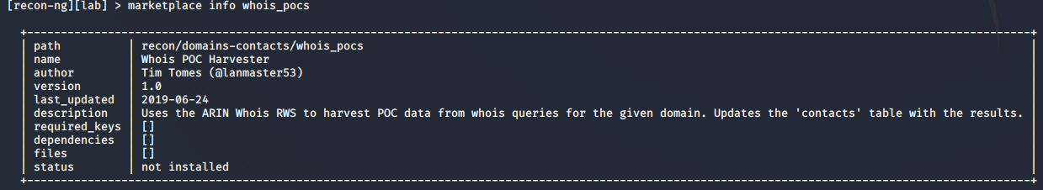
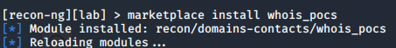
Add Modules
Use marketplace info <module_name> to see some information about the module
Then install it
[recon-ng][lab] > marketplace install whois_pocs
Or we can use `marketplace install all` to install all modules at one time, save a lot of time.

Slide 14
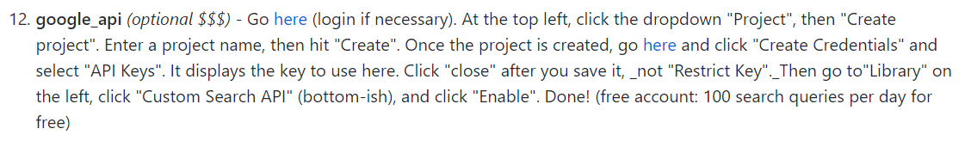
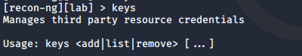
Recon-ng API keys
Recon-ng also works with service API keys
Take a look at the keys we can import
https://github.com/lanmaster53/recon-ng-marketplace/wiki/API-Keys
Getting an API key may be a a bit of a process and outside the scope of this class
Require extra registration, money, etc.
If you want to pursue this, great tutorials for each API are here:
https://github.com/Raikia/Recon-NG-API-Key-Creation/blob/master/README-v4.8.3.md
Example:

Slide 15
Recon-ng
Recon on NYU

Slide 16
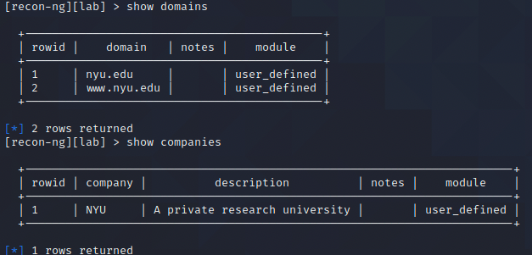
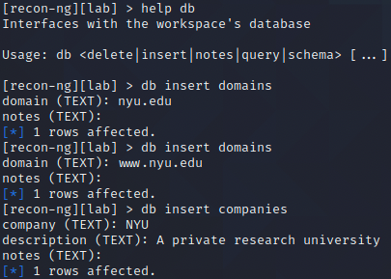
Recon-ng adding a target
Let’s get some of our targets in place with the db command
[recon-ng][lab] > help db
We can also ‘delete’
[recon-ng][lab] > db insert domains
[recon-ng][lab] > db insert companies
Now that we have some targets in place, let’s look at the tables
[recon-ng][lab] > show domains
[recon-ng][lab] > show companies

Slide 17
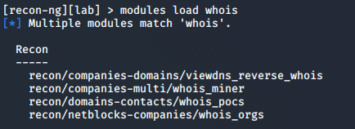
Recon-ng modules
To use a module, we first need to load it
[recon-ng][lab] > modules load [full path of module]
You can use tab competition or just type in part of the name
If there are multiple module possibilities from your string, it will list them
Load up whois_pocs
[recon-ng][lab] > modules load whois_pocs
Notice our prompt switched again
We can drop the module too
[recon-ng][lab][whois_pocs] > back
[recon-ng][lab] >

Slide 18
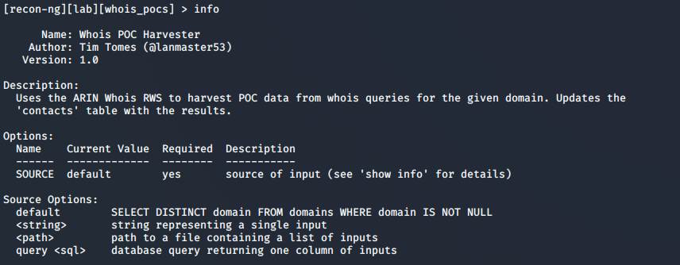
Recon-ng Modules
We can look at what Options the module requires
[recon-ng][lab][whois_pocs] > info
This module requires a SOURCE, like most
If we don’t specify an option, it will query the DOMAINS table and perform this module against every unique domain

Slide 19
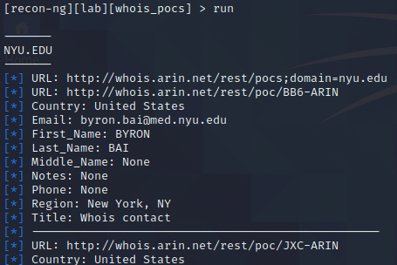
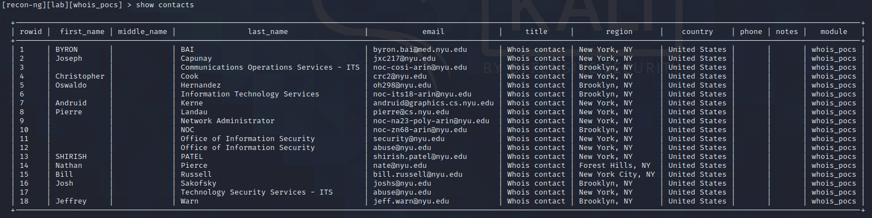
Recon-ng
Run the module using default settings
[recon-ng][lab][whois_pocs] > run
might take a few minutes...
Okay! Now look at your POC table
[recon-ng][lab][whois_pocs] > show contacts

Slide 20
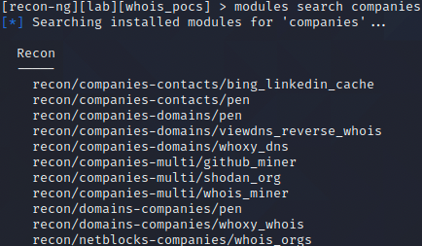
Recon-ng
Let’s try another module
We inputted a company name so search the recon/company-[unknown] modules
[recon-ng][lab][whois_pocs] > modules search companies
Some of these modules will require an API
Signing up for an API is outside the lab’s scope
Requires a Microsoft or LinkedIn Account, really not that hard to get
https://www.microsoft.com/cognitive-services/en-us/bing-web-search-api
https://www.indeed.com/publisher
Whois_miner does not require an API
load it and run
[recon-ng][lab][whois_pocs] > modules load whois_miner
[recon-ng][lab][whois_miner] > run
Did it work?

Slide 21
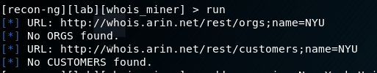
Recon-ng
Fail.
You may also get an SSL handshake error, go back to first slide
Restart recon-ng after changing
CipherString = DEFAULT@SECLEVEL=1

Slide 22
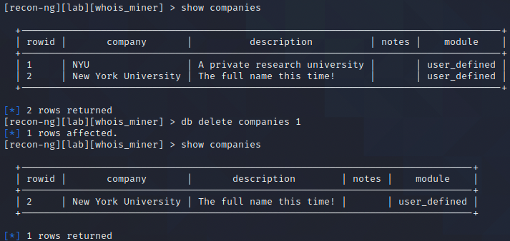
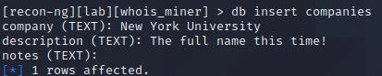
Recon-ng
What can we do to have more success?
Add the full name of NYU
We don’t need to add it all in one line
[recon-ng][lab][whois_miner] > add companies
Add the full name
If you want, delete the old row

Slide 23
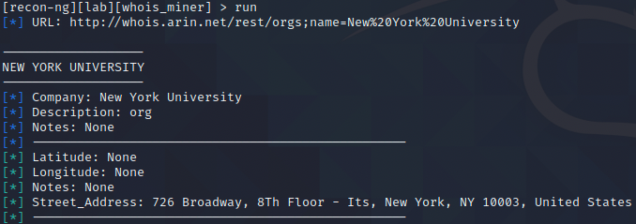
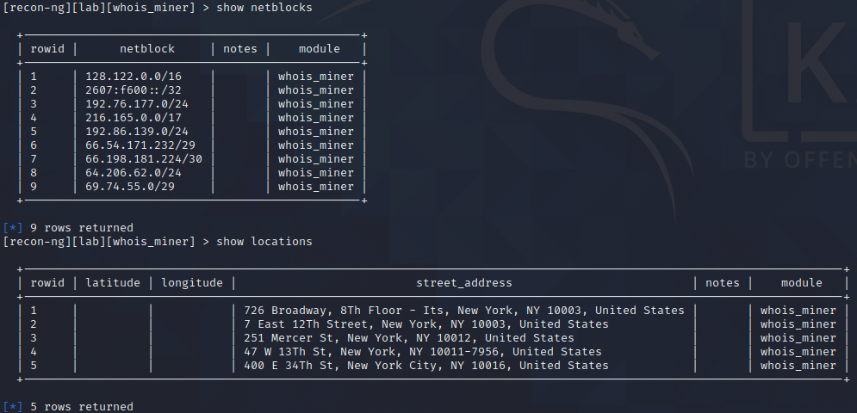
Recon-ng
Let’s try that again, run!
Now we have lots of information
Recon-ng keeps it organized
[recon-ng] > show locations
[recon-ng] > show netblocks

Slide 24
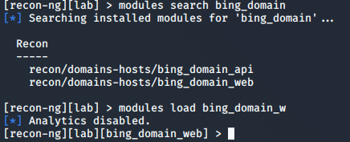
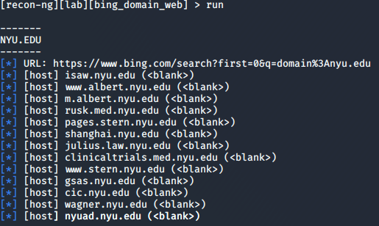
Recon-ng
Let’s keep going with our recon
Load /recon/domains-hosts/bing_domain_web and show info
[recon-ng][lab][whois_pocs] > modules load bing_domain_web
[recon-ng][lab][bing_domain_web] > info
This module again uses defaults and does not require an API, run it
[recon-ng][lab][bing_domain_web] > run
It will take a few minutes but it should work
If we had an API, it would go very quick
Recon-ng ‘sleeps’ to not get caught and blocked
If Google or Bing detect bot activity, they will force the user to complete a captcha on the browser instead of provide results
If that happens, our modules will fail since they're only parsing results pages, not captcha pag
Google stopped offering regular search APIs
Need to configure a "Custom Search" and use that
see above, recon-ng autocompletes

Slide 25
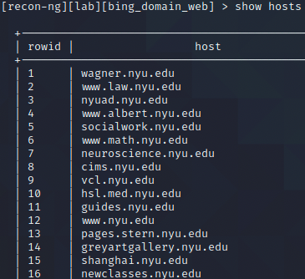
Recon-ng
We can take a look at all the data we got
[recon-ng][lab][bing_domain_web] > show hosts
Well done. What else?
[recon-ng][lab][bing_domain_web] > modules search hosts-
Recon
-----
recon/hosts-domains/migrate_hosts
recon/hosts-hosts/bing_ip
recon/hosts-hosts/freegeoip
recon/hosts-hosts/ipinfodb
recon/hosts-hosts/resolve
recon/hosts-hosts/reverse_resolve
recon/hosts-hosts/ssltools
recon/hosts-locations/migrate_hosts
recon/hosts-ports/shodan_ip
Most of these will require an API

Slide 26
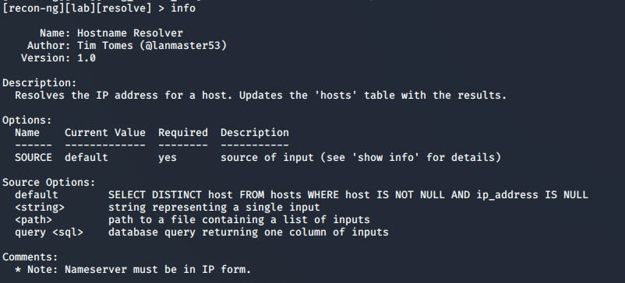
Recon-ng
If we just want to get an IP, let’s load ‘resolve’ and show info
[recon-ng][lab][bing_domain_web] > modules load hosts-hosts/resolve
[recon-ng][lab][resolve] > info
Default options look good again. Run it
[recon-ng][lab][resolve] > run

Slide 27
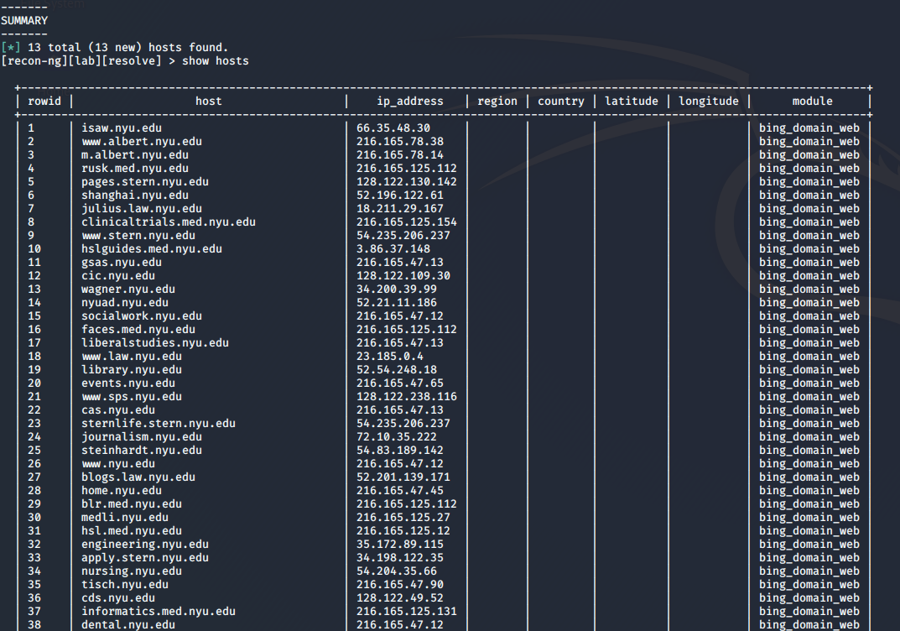
Recon-ng
Now take a look at your hosts table
[recon-ng][lab][resolve] > show hosts
lots of targets
lots of exposed systems
We can begin to map their network

Slide 28
recon-ng: reporting
We can export this data in several formats
[recon-ng][lab][resolve] > modules search report
[*] Searching for 'report'...
Reporting
---------
reporting/csv
reporting/html
reporting/json
reporting/list
reporting/pushpin
reporting/xlsx
reporting/xml
Load and check out the info for csv
[recon-ng][lab][resolve] > modules load reporting/csv
[recon-ng][lab][csv] > info

Slide 29
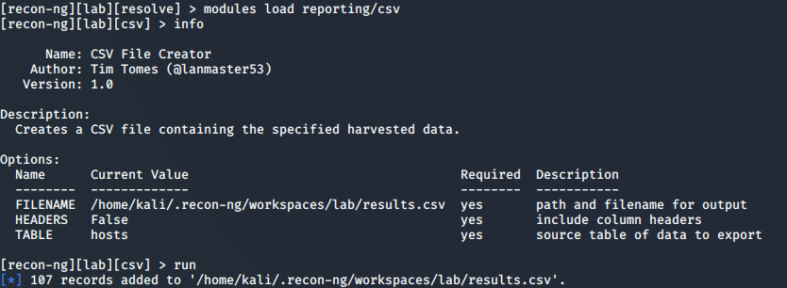
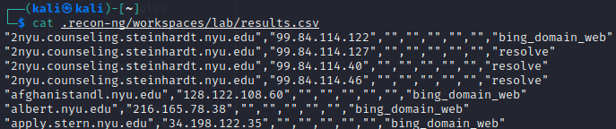
recon-ng reporting
Default looks good
We want the 'hosts' table
Run it
[recon-ng][lab][csv] > run
Then, check out results
$ cat /home/kali/.recon-ng/workspaces/lab/results.csv
A little sloppy, can't yet be used by a tool like nmap

Slide 30
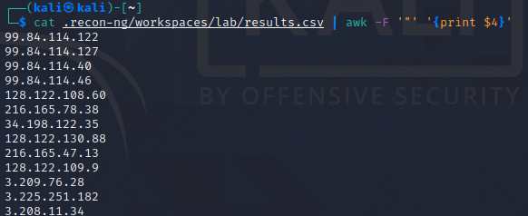
Clean up
One way to clean up the results is to use awk
Use the " character as your delimiter to get a list of IPs
"2nyu.counseling.steinhardt.nyu.edu","54.230.90.12","","","","","bing_domain_web"
# cat /home/kali/.recon-ng/workspaces/lab/results.csv | awk -F'"' '{print $4}'
We can then write this to a file and import it into a scanning tool like nmap to begin the active part of our recon - scanning
There are many ways to learn about what public-facing IP addresses an organization has. This is just one of many. Experiment and read about other modules in recon-ng

Slide 31
Recon-ng
DNS Cache Snooping

Slide 32
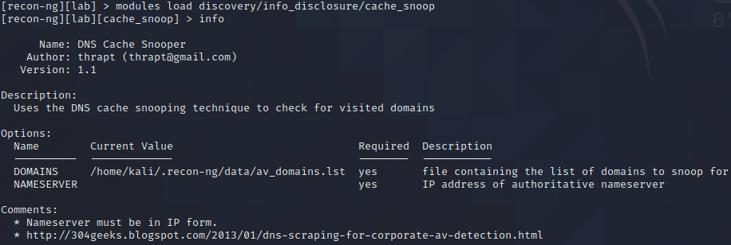
Recon-ng DNS Cache Snoping
As we mentioned in lesson 2, we can disable recursive DNS queries to see what is in the local cache of a nameserver we can query
Let's see if our local gateway can provide info about ourselves
Load one more module
[recon-ng][lab] > modules load discovery/info_disclosure/cache_snoop
[recon-ng][lab][cache_snoop] > info
Two required Options but DOMAINS already has a value. Set the nameserver to your local gateway
[recon-ng][lab][cache_snoop] > options set NAMESERVER [local_gateway_IP]

Slide 33
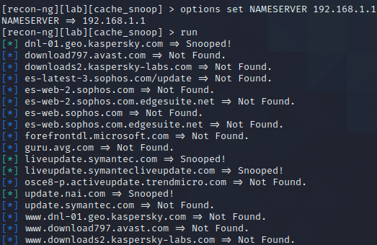
Recon-ng Cache Snoping
Before we run our module, let’s watch the network
If you’re using Kali with a GUI, open up wireshark
[recon-ng][lab][cache_snoop] >shell sudo wireshark &
If you’re using EC2 Kali over ssh, use tcpdump
[recon-ng][lab][cache_snoop] >shell sudo tcpdump –nnX
Now run the command and see if it can tell us about your antivirus
[recon-ng][lab][cache_snoop] > run
Do you see your AV’s update server?
Can you see where no recursion is set in the packets?

Slide 34
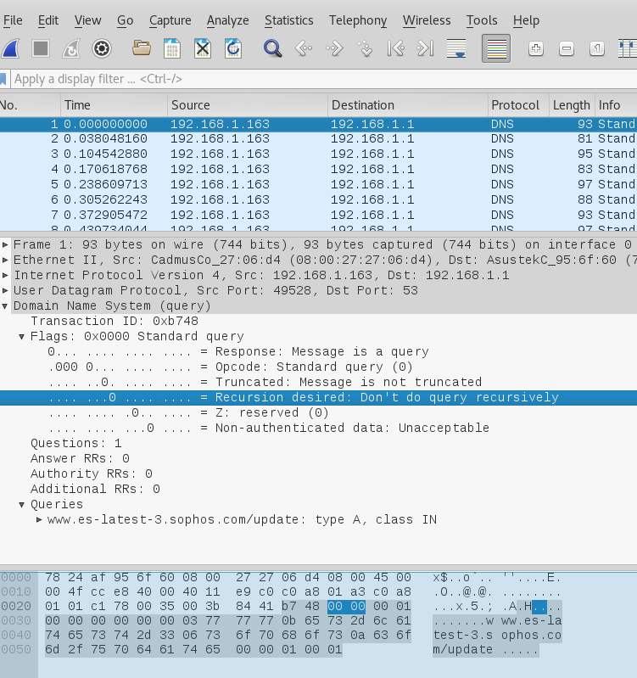
Recon-ng

Slide 35
Amass
OWASP tool for recon

Slide 36
Amass
Amass is a tool written by the good folks at OWASP
Same people that brought you DVWA, ZAP, and OWASP Top 10
Amass is a mass DNS and network enumeration tool
First came out in 2018, now included with Kali
Not a replacement for Recon-ng
May provide additional or different results depending on what modules we use
Homepage - https://owasp.org/www-project-amass/
Guide - https://github.com/OWASP/Amass/blob/master/doc/user_guide.md
This is an on-going problem with using automated tools for anything related to pen testing, including recon. Results may vary from tool to tool

Slide 37
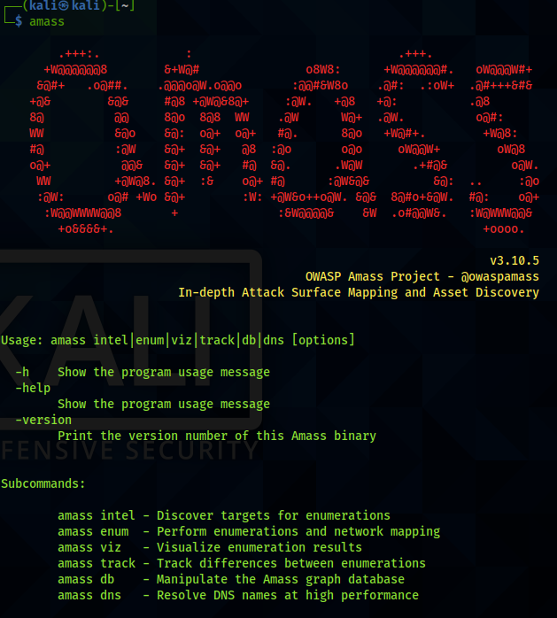
Amass - Installation
Amass comes included with Kali
# amass
Intel – Passive info gathering
Enum – Active enumeration

Slide 38
Amass – Active Recon
Amass intel is passive recon, info gathering on a target
Amass enum is active recon, queries DNS and does network enumeration
Use amass options to also view the source of the finding and resolve the IP
-src and -ip
Output it to a file
# amass enum [options] -d nyu.edu >> [output file]
Compare the results
Which tool provided more?

Slide 39
Recon-ng output
+-----------------------------------------------------------------------------+
| rowid | host | ip_address | module |
+-----------------------------------------------------------------------------+
| 1 | www.stern.nyu.edu | 107.20.182.227 | bing_domain_web |
| 2 | www.nyu.edu | 216.165.47.12 | bing_domain_web |
| 3 | pages.stern.nyu.edu | 128.122.130.142 | bing_domain_web |
| 4 | med.nyu.edu | 216.165.125.27 | bing_domain_web |
| 5 | w3.stern.nyu.edu | 128.122.130.73 | bing_domain_web |
| 6 | cas.nyu.edu | 216.165.47.13 | bing_domain_web |
| 7 | execed.stern.nyu.edu | 23.227.38.64 | bing_domain_web |
| 8 | people.stern.nyu.edu | 128.122.130.142 | bing_domain_web |
| 9 | library.nyu.edu | 52.201.98.53 | bing_domain_web |
| 10 | www.law.nyu.edu | 23.23.101.191 | bing_domain_web |
| 11 | gsas.nyu.edu | 216.165.47.13 | bing_domain_web |
| 12 | as.nyu.edu | 216.165.47.13 | bing_domain_web |
| 13 | classes.nyu.edu | 216.165.46.10 | bing_domain_web |
| 14 | greyartgallery.nyu.edu | 128.122.108.98 | bing_domain_web |
| 15 | nyuad.nyu.edu | 35.168.90.191 | bing_domain_web |
| 16 | steinhardt.nyu.edu | 128.122.109.97 | bing_domain_web |
| 17 | gamecenter.nyu.edu | 104.196.140.105 | bing_domain_web |
| 18 | isaw.nyu.edu | 66.35.39.43 | bing_domain_web |
| 19 | apply.nursing.nyu.edu | 34.198.122.35 | bing_domain_web |
| 20 | apply.stern.nyu.edu | 34.198.122.35 | bing_domain_web |
| 21 | wagner.nyu.edu | 34.200.39.99 | bing_domain_web |
| 22 | www.sps.nyu.edu | 128.122.238.116 | bing_domain_web |
Recon-ng output
| 23 | cs.nyu.edu | 128.122.49.30 | bing_domain_web |
| 24 | web-marketing.stern.nyu.edu | 128.122.130.29 | bing_domain_web |
| 25 | www.math.nyu.edu | 128.122.49.29 | bing_domain_web |
| 26 | events.nyu.edu | 216.165.47.65 | bing_domain_web |
| 27 | itp.nyu.edu | 128.122.157.181 | bing_domain_web |
| 28 | cims.nyu.edu | 128.122.49.28 | bing_domain_web |
| 29 | m.albert.nyu.edu | 216.165.78.14 | bing_domain_web |
| 30 | stern.shanghai.nyu.edu | 18.182.119.242 | bing_domain_web |
| 31 | math.nyu.edu | 128.122.49.29 | bing_domain_web |
| 32 | connect.nyu.edu | 34.198.122.35 | bing_domain_web |
| 33 | patientaccess.dental.nyu.edu | 128.122.238.8 | bing_domain_web |
| 34 | shcportal.nyu.edu | 128.122.104.214 | bing_domain_web |
| 35 | admissionsblog.nyu.edu | 70.40.223.118 | bing_domain_web |
| 36 | engineering.nyu.edu | 35.172.89.115 | bing_domain_web |
| 37 | gallatin.nyu.edu | 216.165.47.12 | bing_domain_web |
| 38 | wireless.engineering.nyu.edu | 52.1.126.186 | bing_domain_web |
| 39 | shibboleth.nyu.edu | 216.165.47.16 | bing_domain_web |
| 40 | apply.engineering.nyu.edu | 34.198.122.35 | bing_domain_web |
| 41 | cn.application.shanghai.nyu.edu | 59.79.127.55 | bing_domain_web |
| 42 | www.stern.nyu.edu | 50.16.220.50 | resolve |
| 43 | library.nyu.edu | 54.85.195.117 | resolve |
| 44 | www.law.nyu.edu | 107.22.217.70 | resolve |
| 45 | nyuad.nyu.edu | 52.6.99.93 | resolve |
+-----------------------------------------------------------------------------+

Slide 40
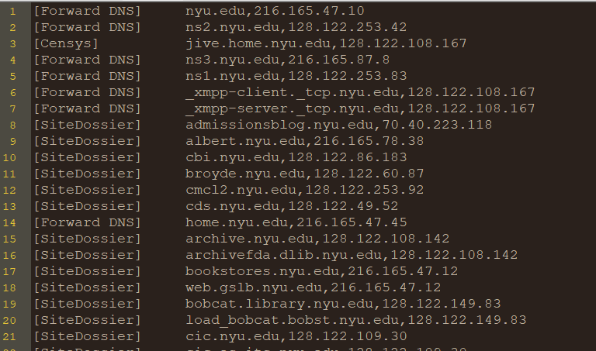
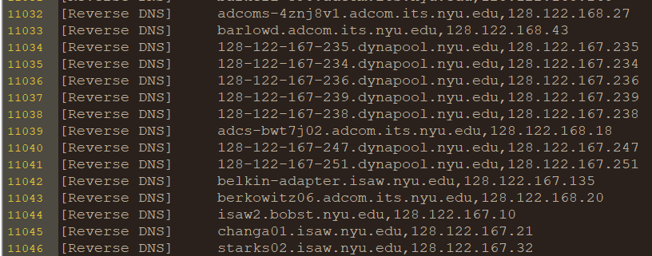
amass output -
11046 unique hosts
# cat ~/nyu_edu.txt | wc -l
11046

Slide 41
Amass output
It looks like amass provides a lot more, but it queries more sources too
About 3000 each from
HackerTarget
FindSubdomains
Reverse DNS
It is also a lot more noisy
Lastly, not all hosts are online / available
To begin making sense, we might want to redirect output to a file
There we can parse, sort, remove duplicates
Remove any false-positive results
e.g. subdomains that are not actually part of NYU, outside scope
Test subdomains (using dig or nslookup) to see if they still resolve to an IP
Finally test remaining hosts to see if they are routable and online

Slide 42
Again - Important Point
A reoccurring problem with automated tools is finding the needle in the haystack
We end up with lots of results, sometimes too many. We need to sift through it, weed out false positives, and make sense of it all
Understanding the tool, what it is doing, and controlling the output is one way to help mitigate this issue and avoid frustration

Slide 43
Metadata
Finding metadata with FOCA, ExifTool, and Strings

Slide 44
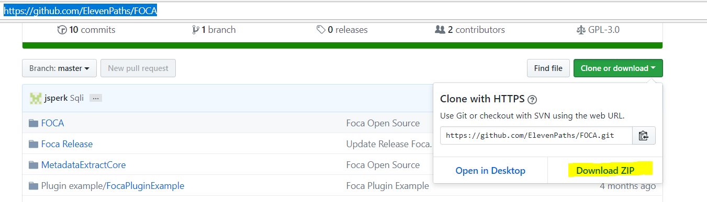
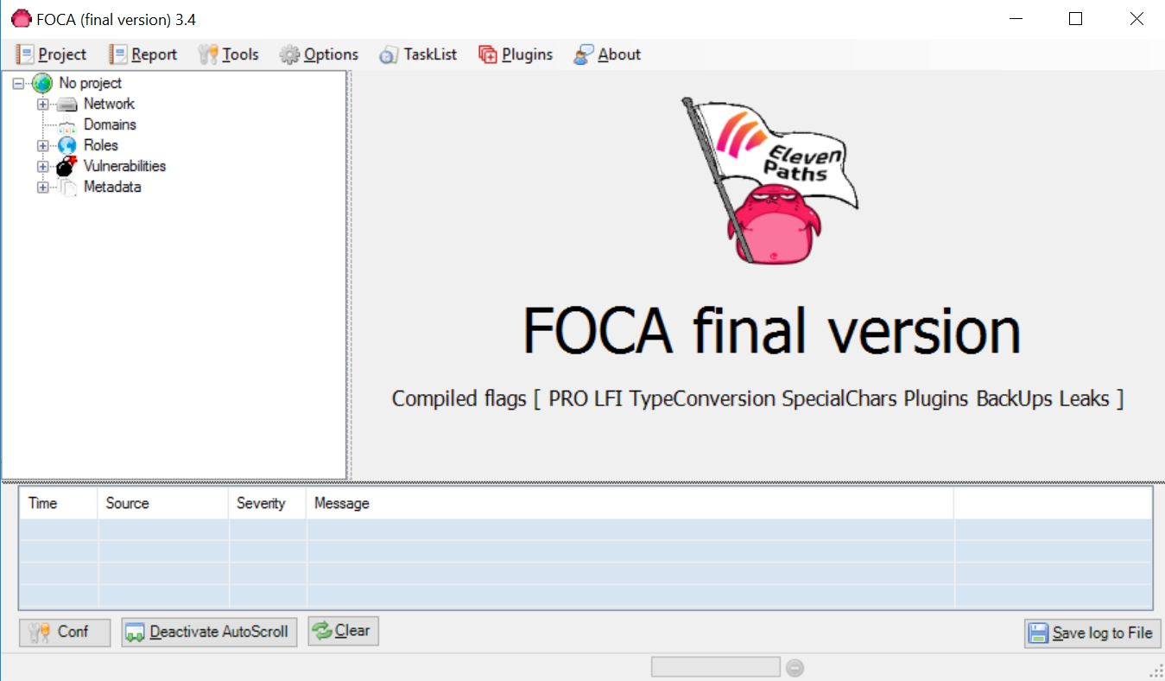
FOCA
For this lab, we will try out two tools and use the file "frontyard.jpg"
Install
https://github.com/ElevenPaths/FOCA
Unzip
Look in the ‘bin’ folder for FOCA.exe

Slide 45
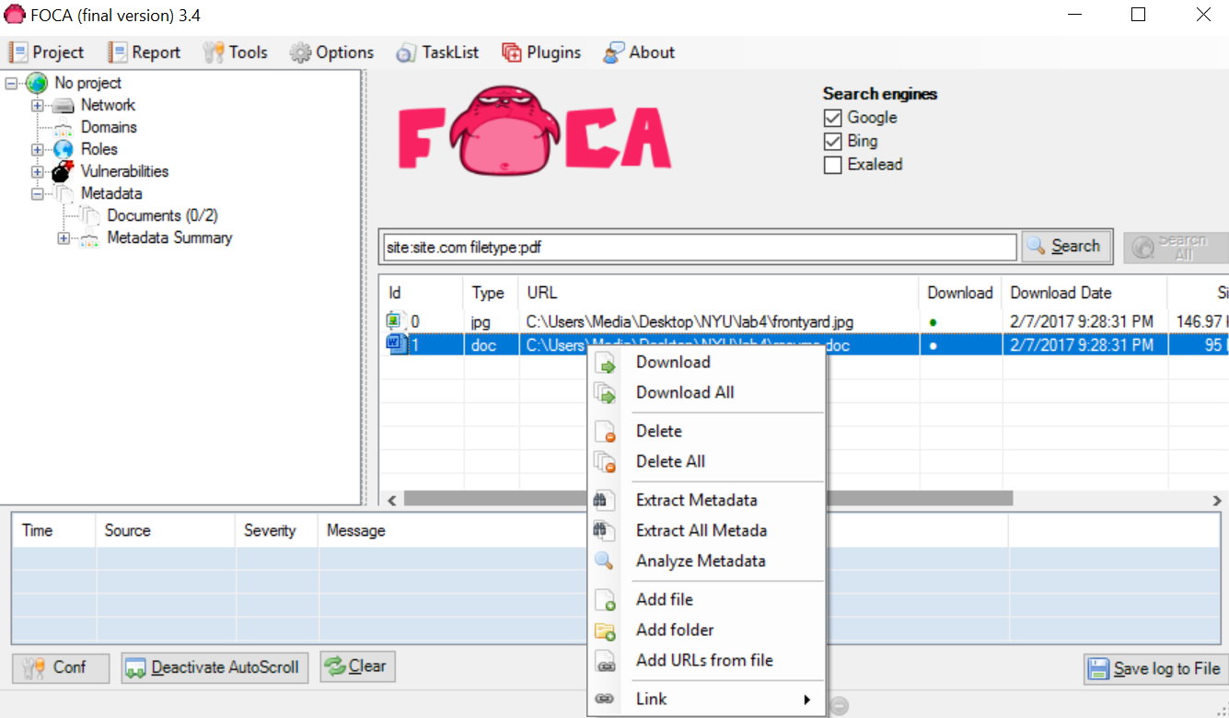
FOCA
Drag and drop files into FOCA
Select Metadata on the left
Right click file(s) and Extract Metadata

Slide 46
ExifTool
Command line tool, better for non-Windows systems
Download and untar
http://www.sno.phy.queensu.ca/~phil/exiftool/Image-ExifTool-10.41.tar.gz
Extract with
# tar –zxvf Image-ExifTool-10.41.tar.gz
Change directories and run with
# cd Image-ExifTool-10.41
# perl exiftool [directory/filename]

Slide 47
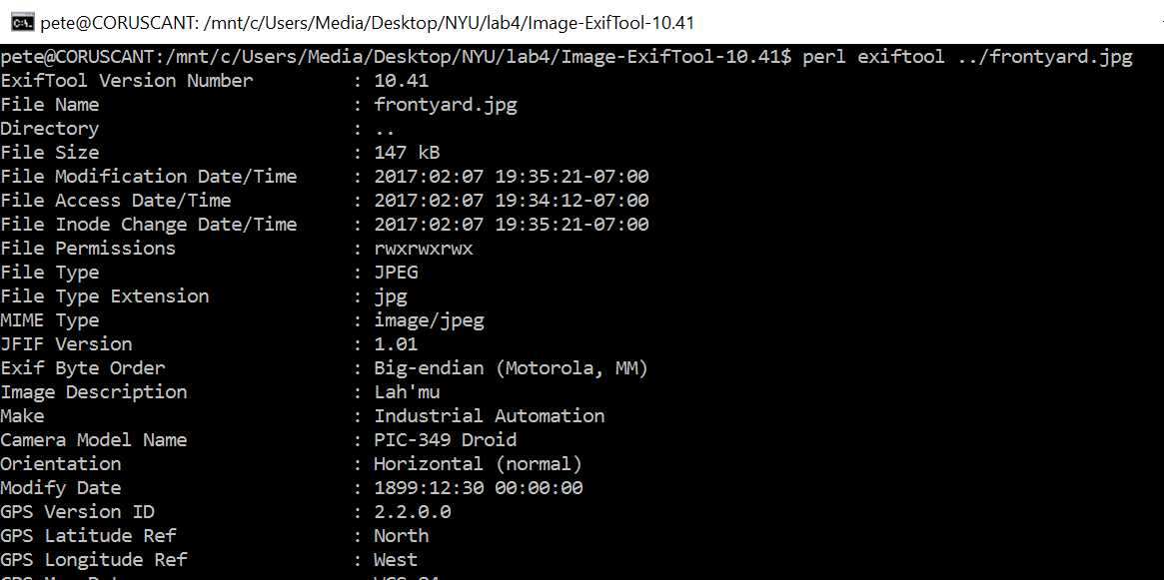
ExifTool

Slide 48
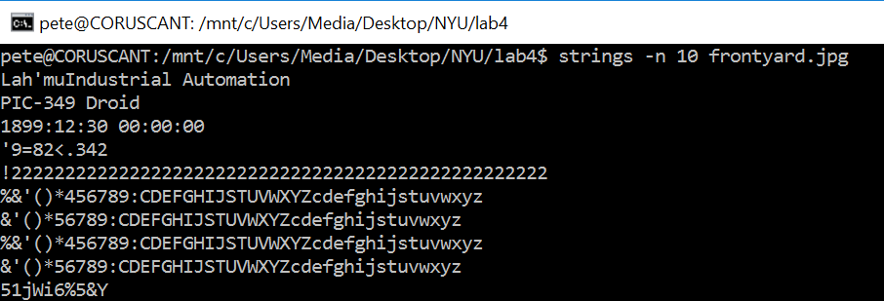
Strings
Should already come with linux
For Bash on Ubuntu on Windows
$ sudo apt-get install binutils
# strings –n [min_length] [file]

Slide 49
Metadata Recon
Target - frontyard.jpg
What is the Camera Model?
In what city was the picture taken?
Anything else interesting in the file, maybe not part of metadata?

Slide 50
ANSWERS

Slide 51
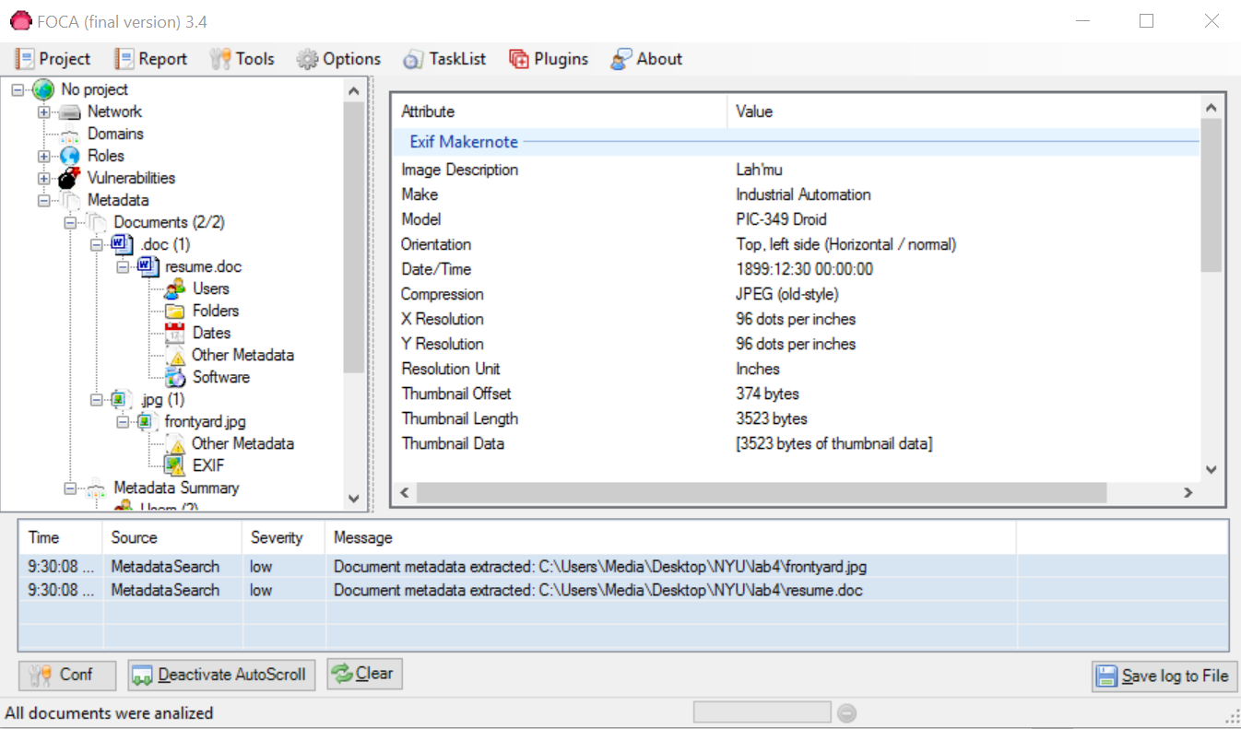
Camera
Expand and we can see the data, camera is a PIC-349 Droid

Slide 52
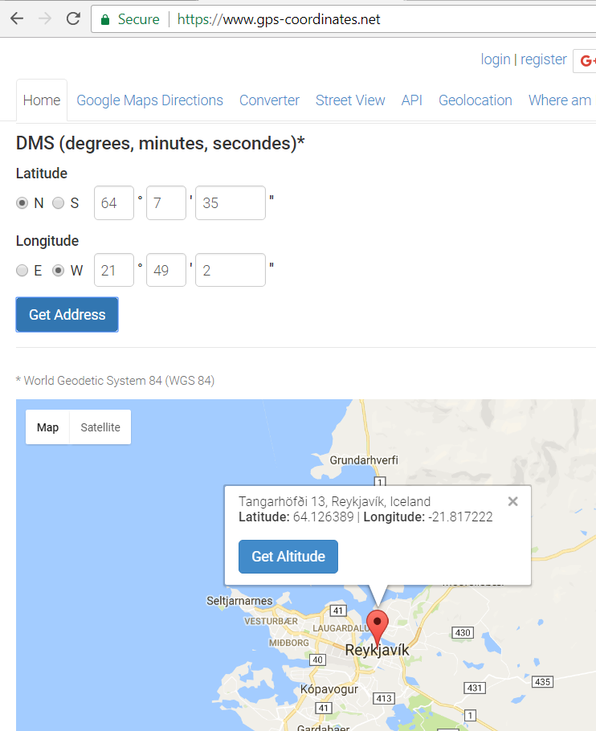
Location
We found the GPS coordinates, need to research

Slide 53
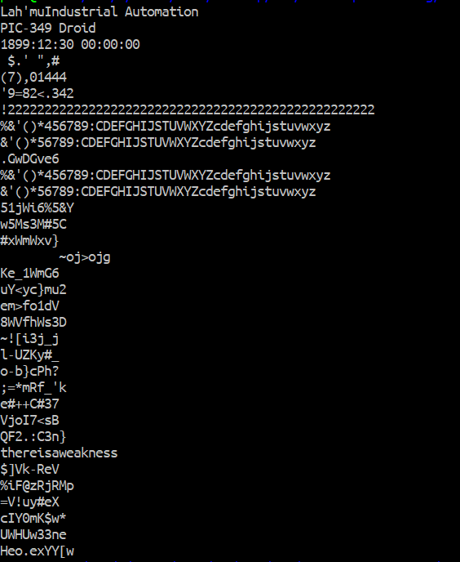
Interesting
# strings frontyard.jpg -n 8

Slide 54
Recon on class slides
Try performing recon via metadata analysis on the slides for this lab or other means, such as the recorded lecture
What can you tell about my computer? Software? Versions?
What other hosts exist on my home network?
What is the IP address block of my home?
You can perform recon from many different places
Make sure you adjust your level of rigor - do not become a victim of information analysis paralysis
At some point, you will need to move onto the next steps of your pen test
Double back to recon only if you have exhausted your attack options with no results

